Slide 1
DESTINY-Gastric04: T-DXd vs Ramucirumab + Paclitaxel as Second-line Therapy for HER2+ Unresectable/Metastatic Gastric Cancer or GEJ Adenocarcinoma
CCO Independent Conference Coverage* of the ASCO Annual Meeting 2025, May 30 - June 3, 2025
*CCO is an independent medical education company that provides state-of-the-art medical information to healthcare professionals through conference coverage and other educational programs.
Mohammed Alawak,MD
SAO Conference 30th
Seven Gate, Damascus,
4\12\2025
Provided by Clinical Care Options, LLC
This program is supported by educational grants from Daiichi Sankyo, Inc. and Genentech, a member of the Roche Group.
Notes:
DESTINY-Gastric04: data from a multicenter, randomized, open-label phase III trial of second-line T-DXd or ramucirumab and paclitaxel in HER2-postitive metastatic/unresectable gastric or gastroesophageal junction adenocarcinoma

Slide 2

About These Slides
Please feel free to use and share some or all of these slides in your noncommercial presentations to colleagues or patients
When using our slides, please retain the source attribution:
These slides may not be published, posted online, or used in commercial presentations without permission. Please contact permissions@clinicaloptions.com for details
Slide credit: clinicaloptions.com
Notes:
Disclaimer: The materials published on the Clinical Care Options website reflect the views of the authors of the CCO material, not those of Clinical Care Options, LLC, the CME providers, or the companies providing educational grants. The materials may discuss uses and dosages for therapeutic products that have not been approved by the United States Food and Drug Administration. A qualified healthcare professional should be consulted before using any therapeutic product discussed. Readers should verify all information and data before treating patients or using any therapies described in these materials.

Slide 3
DESTINY-Gastric04: Background
Approximately 5% to 17% of metastatic gastric cancers (GC) are HER2+ (IHC3+ or IHC2+/ISH+)¹
First-line therapy for HER2+ metastatic GC/GEJ adenocarcinoma (GEJA) is trastuzumab + chemotherapy ± pembrolizumab based on PD-L1 status²
T-DXd is approved for adults with locally advanced or metastatic HER2+ GC/GEJA who have received a prior trastuzumab-based regimen based on results from phase II DESTINY-Gastric01/02/06 trials³
Phase III RAINBOW trial evaluated ramucirumab + paclitaxel vs placebo plus paclitaxel in patients with previously treated GC/GEJA and showed survival improvement with addition of ramucirumab to chemotherapy,⁴ supporting its use as SoC in this setting
Current analysis of phase III DESTINY-Gastric04 reports the efficacy and safety of second-line T-DXd vs ramucirumab + paclitaxel in patients with HER2+ advanced GC/GEJA⁵
1. Janjigian. Ann Oncol. 2013;10: 2656. 2. ESMO Gastric Cancer Living Guideline. V1.4. 2024. 3. fam-T-DXd PI. 4. Wilke. Lancet Oncol. 2014;15:1224. 5. Shitara. ASCO 2025. Abstr LBA4002. Shitara. NEJM. 2025;[Epub].

Slide 4
DESTINY-Gastric04: Study Design
Global, multicenter, randomized phase III trial
Stratified by: HER2 status (IHC 3+ vs 2+/ISH+); geographic location (Asia [excl mainland China] vs Western Europe vs mainland China/rest of world); Time to progression on 1L therapy (<6 mo vs ≥6 mo)
Patients with HER2+ (IHC3+ or IHC2+/ISH+) GC and GEJA; HER2 status confirmed on recent biopsy obtained after progression on trastuzumab; no clinically active CNS metastases; ECOG PS 0/1
(N = 494)
T-DXd
6.4 mg/kg Q3W
(n = 246)
1:1
Ramucirumab + Paclitaxel*
(n = 248)
*Ramucirumab 8 mg/kg on Days 1 and 15 and paclitaxel 80 mg/m² on Days 1, 8, and 15 of 28-day cycle.
Primary endpoint: OS
Key secondary endpoints: PFS, confirmed ORR, DCR, DoR, safety
Exploratory endpoints: patient-reported outcomes
NCT04704934. Shitara. ASCO 2025. Abstr LBA4002. Shitara. NEJM. 2025;[Epub].

Slide 5
DESTINY-Gastric04: Baseline Characteristics
Parameter | T-DXd (n = 246) | R + P (n = 248)
Mean age, yr (range) | 63.2 (21.1-84.1) | 64.3 (31.9-87.0)
Male, n (%) | 187 (76.0) | 205 (82.7)
Geography, n (%) Asia (ex-China) Western Europe Other* | 57 (23.2) 140 (56.9) 49 (19.9) | 60 (24.2) 139 (56.0) 49 (19.8)
Race, n (%) White Black Asian Other | 116 (47.2) 0 101 (41.1) 28 (11.4) | 130 (52.4) 2 (0.8) 97 (39.1) 19 (7.7)
ECOG PS, % 0/1 2/missing | 39.4/60.2 0.4/0 | 35.5/63.7 0.4/0.4
Tumor location, n (%) Gastric GEJ | 153 (62.2) 93 (37.8) | 149 (60.1) 99 (39.9)
Parameter, n (%) | T-DXd (n = 246) | R + P (n = 248)
HER2 status IHC 2+/ISH+ IHC 3+ | 39 (15.9) 207 (84.1) | 40 (16.1) 208 (83.9)
TTP on 1L therapy <6 mo ≥6 mo | 61 (24.8) 185 (75.2) | 61 (24.6) 187 (75.4)
Prior treatment with ICI | 39 (15.9) | 38 (15.3)
Metastatic sites <2 ≥2 | 73 (29.7) 173 (70.3) | 75 (30.2) 173 (69.8)
Liver metastases | 147 (59.8) | 158 (63.7)
Brain metastases | 16 (6.5) | 18 (7.3)
A total of 51.2% and 47.6% of patients in the T-DXd and R + P arm received any subsequent treatment
21% who discontinued R + P went on to receive T-DXd and 4.8% got disitamab vedotin as subsequent systemic anticancer therapy
*Includes mainland China and rest of the world
Shitara. ASCO 2025. Abstr LBA4002. Shitara. NEJM. 2025;[Epub].

Slide 6
DESTINY-Gastric04: OS (Primary Endpoint)
100
T-DXd mOS: 14.7 Mo
83.5%
80
HR: 0.70 (95% CI: 0.55-0.90; P = .0044)
74.4%
57.6%
60
∆3.3 Mo
OS Probability (%)
40
EAM +PTX mOS: 11.4 Mo
48.9%
29.0%
20
13.9%
0
0
3
6
9
12
15
18
21
24
27
30
33
36
39
42
Patients Still at Risk
T-DXd
RAM + PTX
Mo
246
248
219
204
185
150
134
109
94
76
65
52
45
36
30
18
21
9
12
4
2
3
1
3
1
0
1
0
Compared with ramucirumab + paclitaxel, T-DXd led to statistically significant and meaningful improvement in OS (HR: 0.70; P = .0044)
OS benefit with T-DXd vs ramucirumab + paclitaxel was sustained across most patient subgroups
Shitara. ASCO 2025. Abstr LBA4002. Shitara. NEJM. 2025;[Epub].

Slide 7
DESTINY-Gastric04: ORR, DoR, PFS, and PROs
Parameter | T-DXd (n = 246) | R + P (n = 248)
Confirmed ORR, % (95% CI) | 44.3 (37.8-50.9) | 29.1 (23.4-35.3)
P value Difference (95% CI) | .0006 15.1 (6.1-24.2)
Median DoR, mo (95% CI) | 7.4 (5.7-10.1) | 5.3 (4.1-5.7)
DCR, % (95% CI) | 91.9 (87.7-95.1) | 75.9 (70.0-81.2)
Confirmed BOR, n (%) CR PR SD PD NE | 7 (3.0) 97 (41.3) 112 (47.7) 13 (5.5) 6 (2.6) | 3 (1.3) 66 (27.8) 111 (46.8) 22 (9.3) 35 (14.8)
Median PFS, mo | 6.7 | 5.6
HR (95% CI) P value | 0.74 (0.59-0.92) .0074
No substantial changes were observed on the EQ-5D-5L VAS and FACT-Ga Gastric Cancer Subscale outcome scores; patient HRQoL was stable with no notable changes during tx
Shitara. ASCO 2025. Abstr LBA4002. Shitara. NEJM. 2025;[Epub].

Slide 8
DESTINY-Gastric04: Safety Summary
Event, n (%) | T-DXd (n = 244) | R + P (n = 233)
Any TEAE Drug related | 244 (100) 227 (93.0) | 228 (97.9) 213 (91.4)
Grade ≥3 TEAEs Drug related | 166 (68.0) 122 (50.0) | 172 (73.8) 126 (54.1)
Serious TEAEs Drug related | 100 (41.0) 45 (18.4) | 101 (43.3) 41 (17.6)
TEAEs associated with dose discontinuation Drug related | 35 (14.3) 28 (11.5) | 40 (17.2) 31 (13.3)
TEAEs associated with dose interruption Drug related | 137 (56.1) 94 (38.5) | 141 (60.5) 119 (51.1)
TEAEs associated with dose reduction Drug related | 77 (31.6) 76 (31.1) | 87 (37.3) 84 (36.1)
TEAEs associated with death Drug related | 22 (9.0) 4 (1.6) | 35 (15.0) 2 (0.9)
Median duration of tx:
T-DXd: 5.4 mo (range: 0.7-30.3)
R + P: 4.6 mo (range: 0.9-34.9)
Similar rates of drug-related grade ≥3 TEAEs, serious TEAE, and deaths between tx groups
Shitara. ASCO 2025. Abstr LBA4002. Shitara. NEJM. 2025;[Epub].

Slide 9
DESTINY-Gastric04: Select Drug-Related TEAEs
TEAE, % | T-DXd |  | R + P
 | All | Gr ≥3 | All | Gr ≥3
Fatigue | 48.0 | 7.0 | 37.8 | 2.6
Neutropenia | 48.0 | 28.7 | 48.9 | 35.6
Nausea | 44.3 | 4.9 | 14.2 | 0.0
Anemia | 31.1 | 13.9 | 33.0 | 13.7
Decreased appetite | 29.1 | 2.0 | 18.0 | 1.3
Leukopenia | 26.6 | 7.4 | 22.3 | 12.4
Thrombocytopenia | 26.6 | 8.6 | 13.7 | 3.0
Diarrhea | 25.8 | 1.2 | 20.2 | 2.1
Alopecia | 24.2 | 0.0 | 26.6 | 0
Elevated transaminases | 21.7 | 2.0 | 9.4 | 0.4
TEAE, % | T-DXd |  | R + P
 | All | Gr ≥3 | All | Gr ≥3
Vomiting | 20.1 | 2.9 | 6.9 | 0.4
ILD/pneumonitis | 13.9 | 0.4 | 1.3 | 1.3
Decreased weight | 11.1 | 1.2 | 3.9 | 0.4
Constipation | 10.7 | 0.0 | 5.2 | 0.0
Lymphopenia | 10.2 | 2.0 | 5.6 | 1.3
Stomatitis | 4.9 | 0.4 | 14.2 | 0.4
Neuropathy | 2.5 | 0.0 | 29.2 | 3.4
Epistaxis | 1.6 | 0.0 | 12.9 | 0.4
Hypertension | 0.4 | 0.0 | 15.5 | 8.2
Notable AE, % | Gr 1/2 | Gr ≥3 | Gr 1/2 | Gr ≥3
ILD/pneumonitis | 13.6 | 0.4* | 0 | 1.3*
LV dysfunction | 1.2 | 1.2* | 1.7 | 0
*No grade 4 ILD or LV events with either regimen; 1 grade 5 ILD event with R + P; no grade 5 LV events with either regimen
Shitara. ASCO 2025. Abstr LBA4002. Shitara. NEJM. 2025;[Epub].

Slide 10
DESTINY-Gastric04: Investigator’s Conclusions
In phase III DESTINY-Gastric04 trial, T-DXd showed statistically significant and clinically meaningful improvement in OS as second-line therapy for HER2+ metastatic GC/GEJA vs ramucirumab + paclitaxel
Median OS: 14.7 vs 11.4 mo (HR: 0.70; P = .0044)
Improvement also noted in PFS, confirmed ORR, DCR, and DoR with T-DXd vs ramucirumab + paclitaxel
No new safety signals were reported and patient-reported QoL was maintained
Investigators concluded that T-DXd represents a second-line SoC treatment for patients with HER2+ metastatic GC/GEJA and suggest it should be evaluated in earlier line settings
Shitara. ASCO 2025. Abstr LBA4002. Shitara. NEJM. 2025;[Epub].

Slide 11
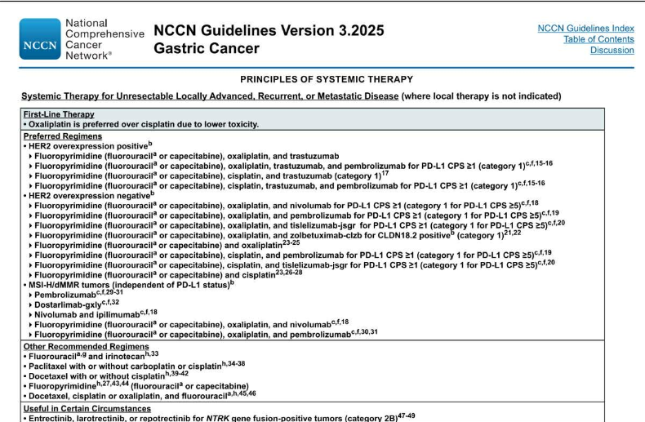

Slide 12
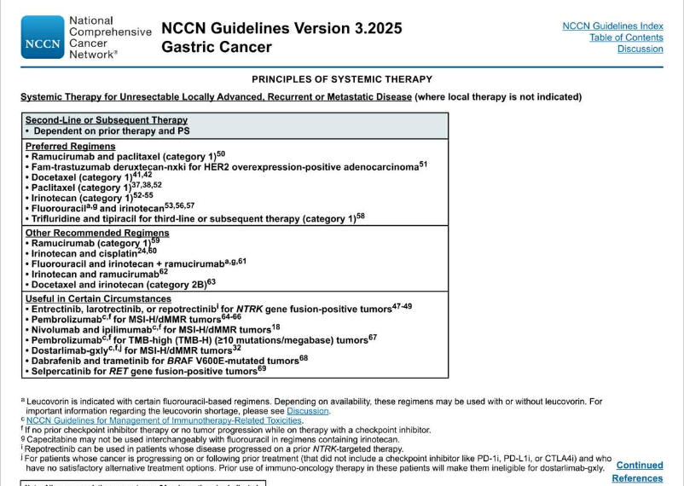

Slide 13


